Slide 1
Statistical Parsing
Jurafsky and Martin Chapter 12
Based on slides from Sameer Singh, Dan Jurafsky, Noah Smith, Slav Petrov, and everyone else they copied from.

Slide 2
Outline
Parsing: CKY Algorithm
Extensions: Probabilistic and Lexicalized
Dependency Parsing

Slide 3
Ambiguity: Which parse?
Time flies like an arrow.

Slide 4
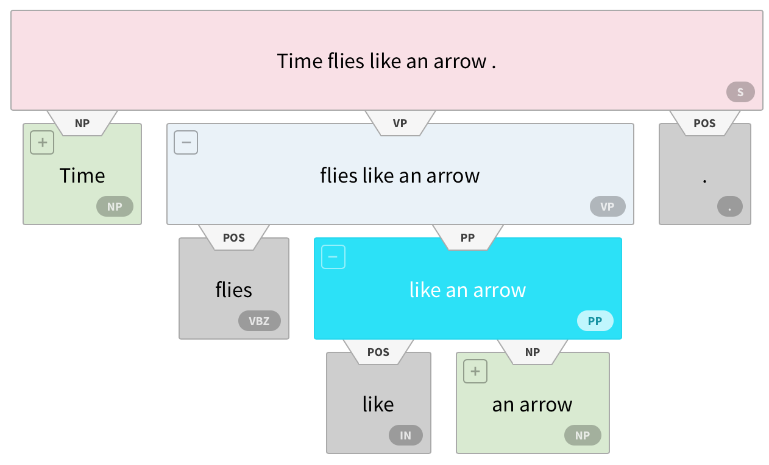
Ambiguity: Which parse?
Time flies like an arrow.
https://demo.allennlp.org/constituency-parsing
Notes:
Figure from https://demo.allennlp.org/constituency-parsing

Slide 5
Ambiguity: Which parse?
Fruit flies like a banana.

Slide 6
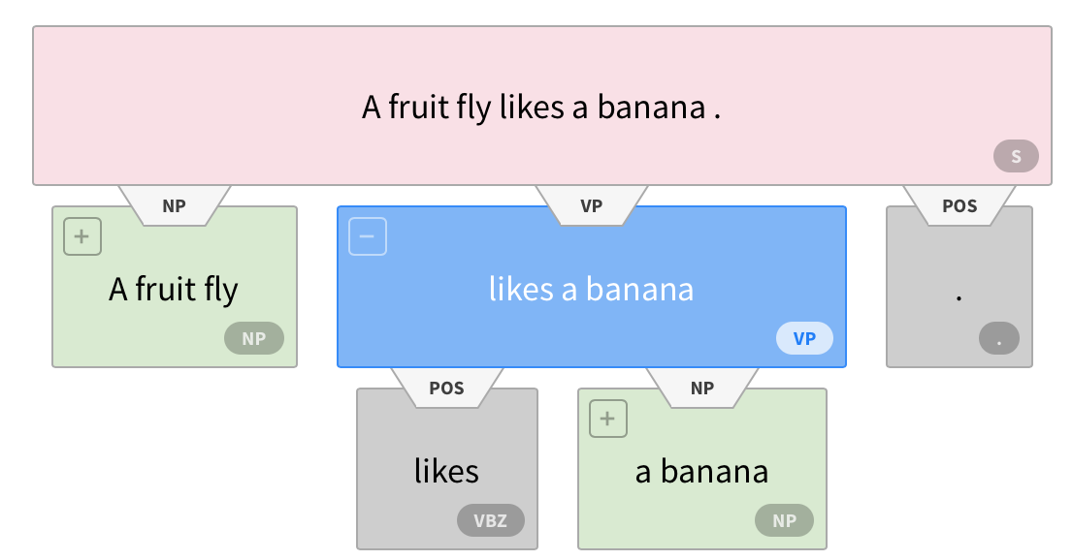
Ambiguity: Which parse?
Fruit flies like a banana.

Slide 7
Ambiguity: Which parse?
Fruit flies like a banana.

Slide 8
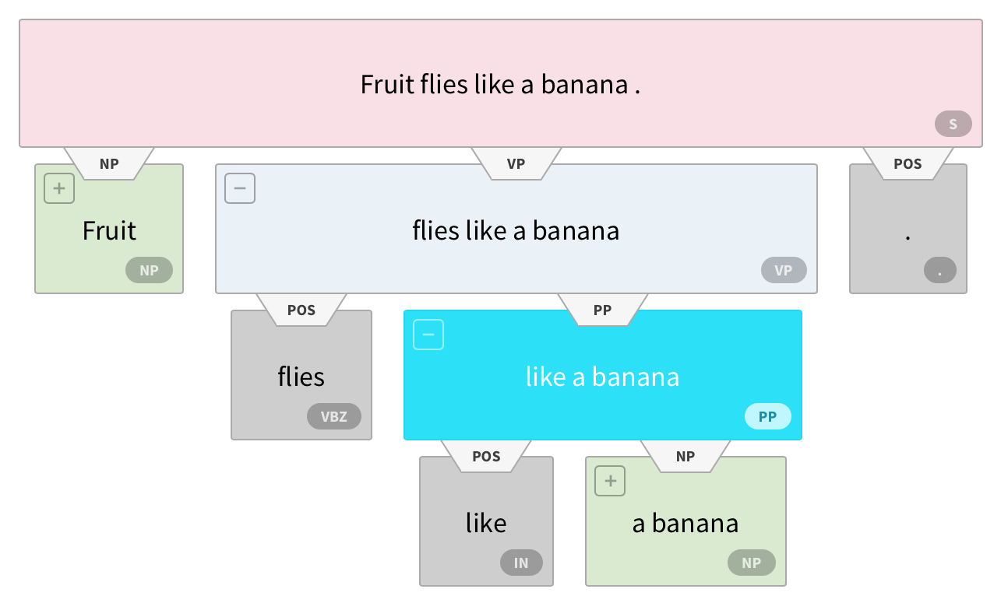
Ambiguity: Which parse?
Fruit flies like a banana.

Slide 9
Ambiguity: Which parse?
Fruit flies like a banana.

Slide 10
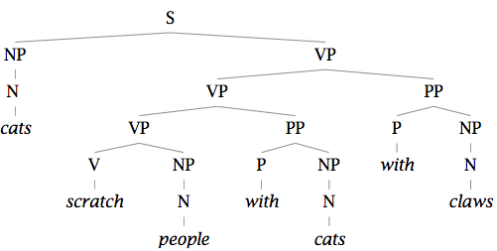
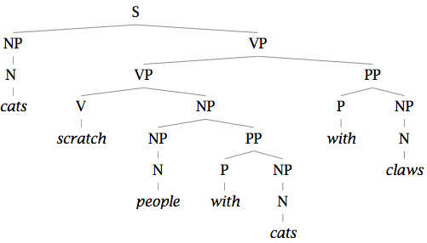
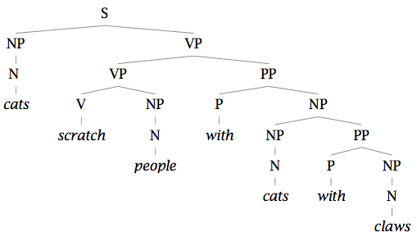
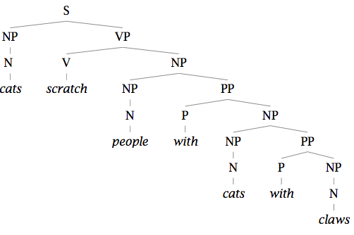
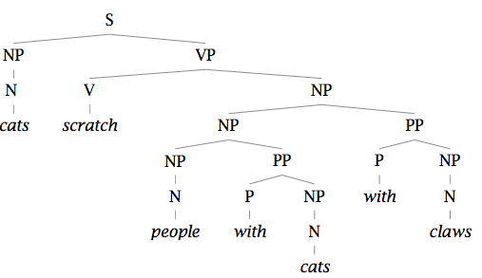
Finding the Best Parse Tree
Cats scratch people with cats with claws.

Slide 11
Finding the Best Parse Tree
Cats scratch people with cats with claws.

Slide 12
Probabilistic CFGs
Same as a regular context-free grammar:
Terminal, non-terminals, and rules
Additionally, attach a probability to each rule!
Rule: A → B C
Probability: P(A → B C | A)
Compute the probability of a parse tree:

Slide 13
Probabilistic CFGs
Same as a regular context-free grammar:
Terminal, non-terminals, and rules
Additionally, attach a probability to each rule!
Rule: A → B C
Probability: P(A → B C | A)
Compute the probability of a parse tree:

Slide 14
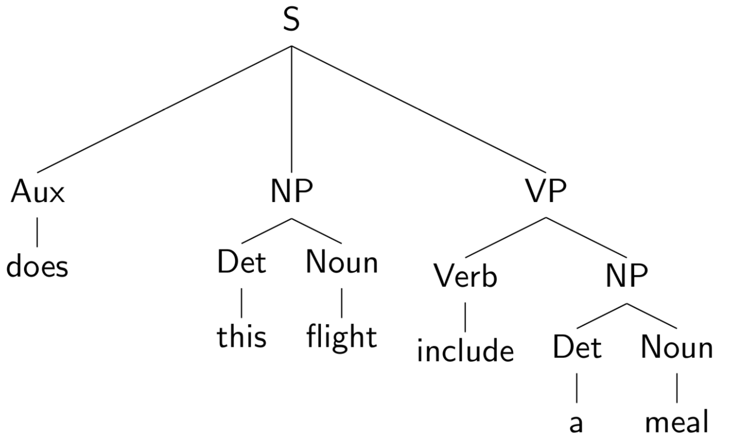
Example of a PCFG

Slide 15
Example of a PCFG

Slide 16
Estimating the probabilities

Slide 17
Estimating the probabilities

Slide 18
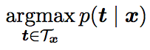
The Parsing Problem
Given sentence x and grammar G,
Recognition
Is sentence x in the grammar? If so, prove it.
“Proof” is a deduction, valid parse tree.
Parsing
Show one or more derivations for x in G.
Even with small grammars, grows exponentially!

Slide 19
Probabilistic CKY Algorithm
T[i,j,A] = Probability of the best parse with root A for the span (i,j)
A
(j-1,j)
Rule: P( A → word[j] )
Base case
T[j-1,j,A] = P(word[j] | A)
word[j]
Recursion
Rule: P( A → B C )
(i,j)
A
Try every position k, and every non-terminal pair:
B
C
T[i,j,A] = max P(B C| A) T[i,k,B] T[k,j,C]
(i,k)
(k,j)

Slide 20
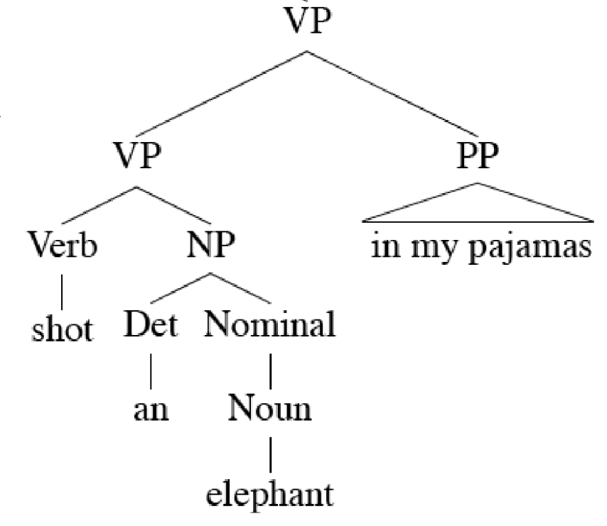
Lexicalized PCFGs
Notes:
Eat pizza with peperoni versus Eat pizza with a fork

Slide 21
Lexicalized PCFGs

Slide 22
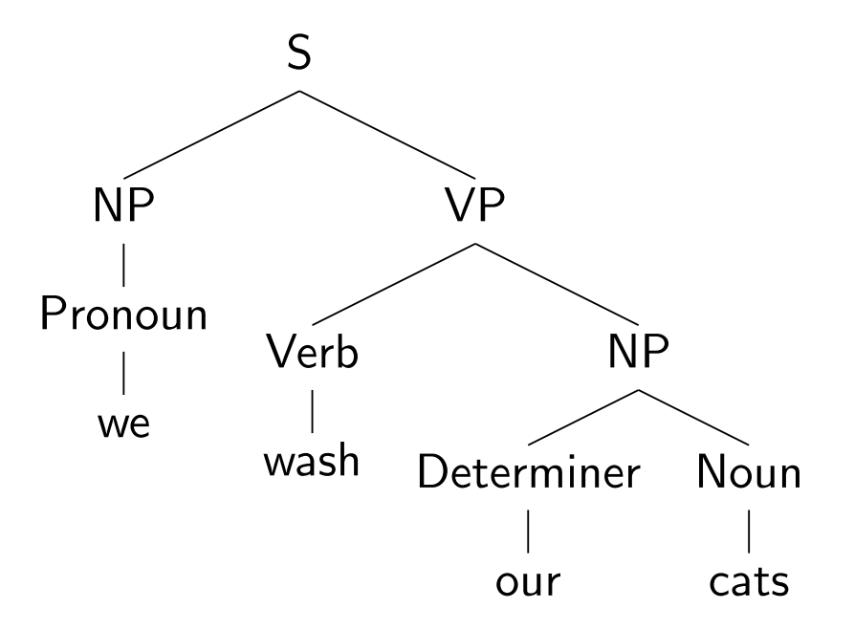
Lexicalizing a CFG

Slide 23
Lexicalizing a CFG

Slide 24
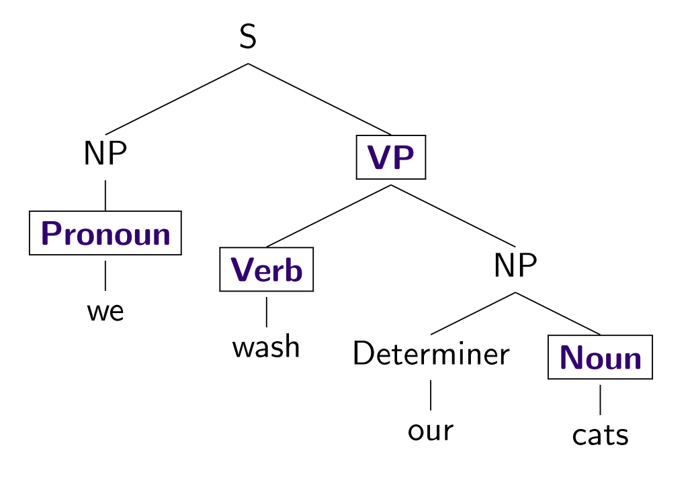
Lexicalizing a CFG

Slide 25
Lexicalizing a CFG

Slide 26
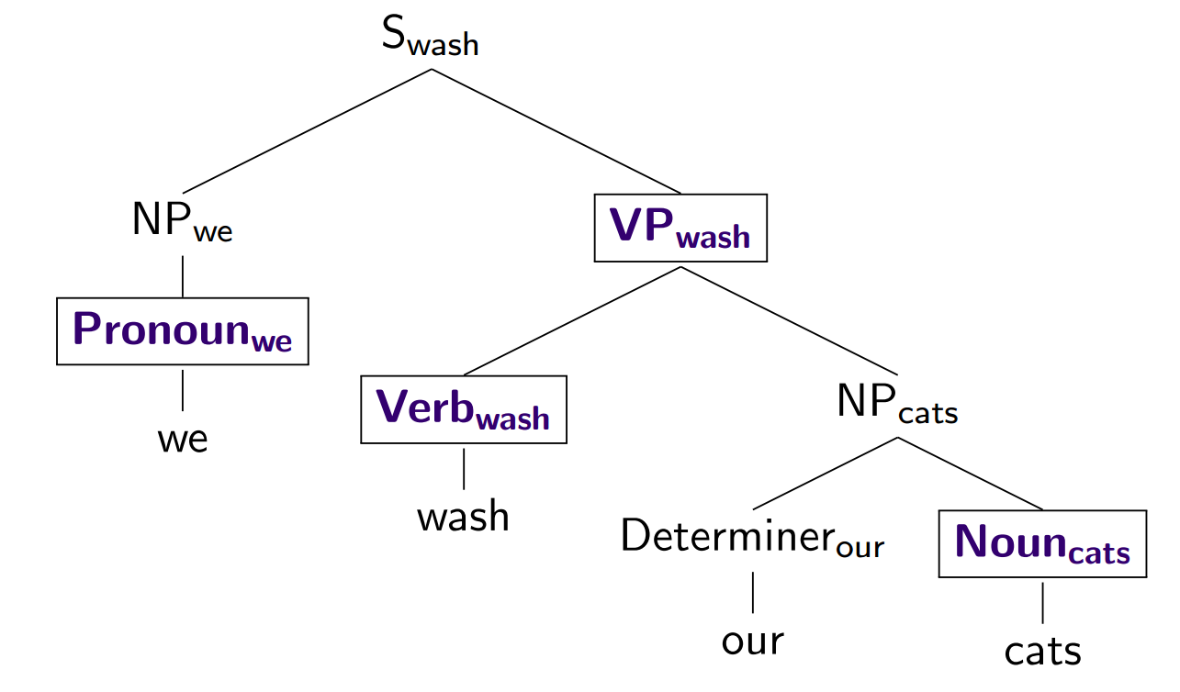
Lexicalizing a CFG

Slide 27
Outline
Parsing: CKY Algorithm
Extensions: Probabilistic and Lexicalized
Dependency Parsing

Slide 28
Dependencies
Represent only the syntactic dependencies…

Slide 29
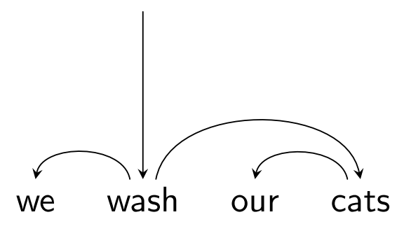
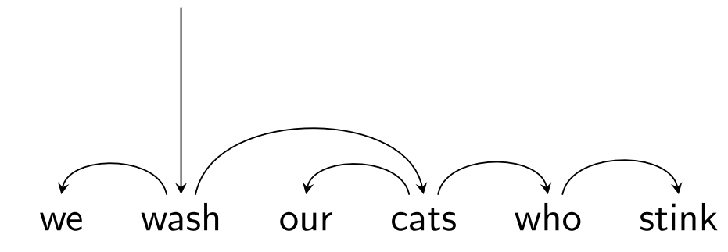
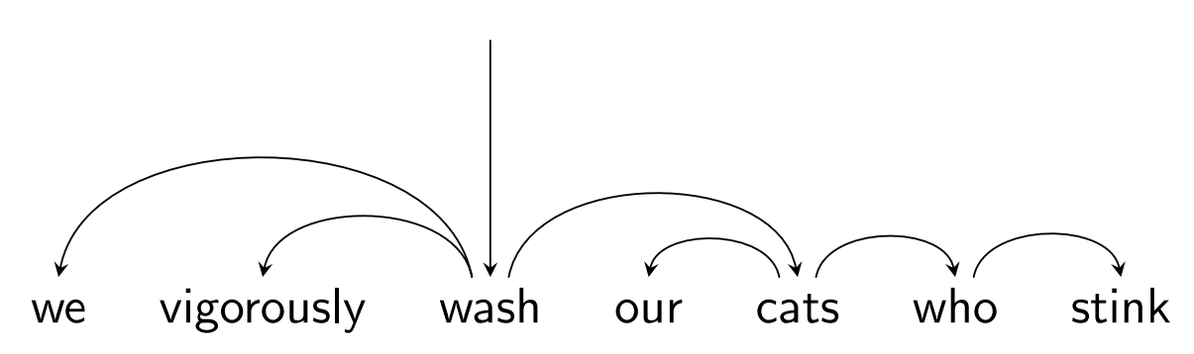
Nested Structure = Subtrees

Slide 30
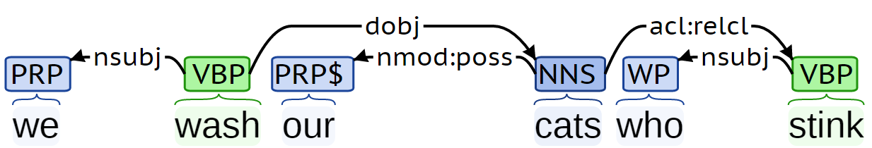
Dependency Labels

Slide 31
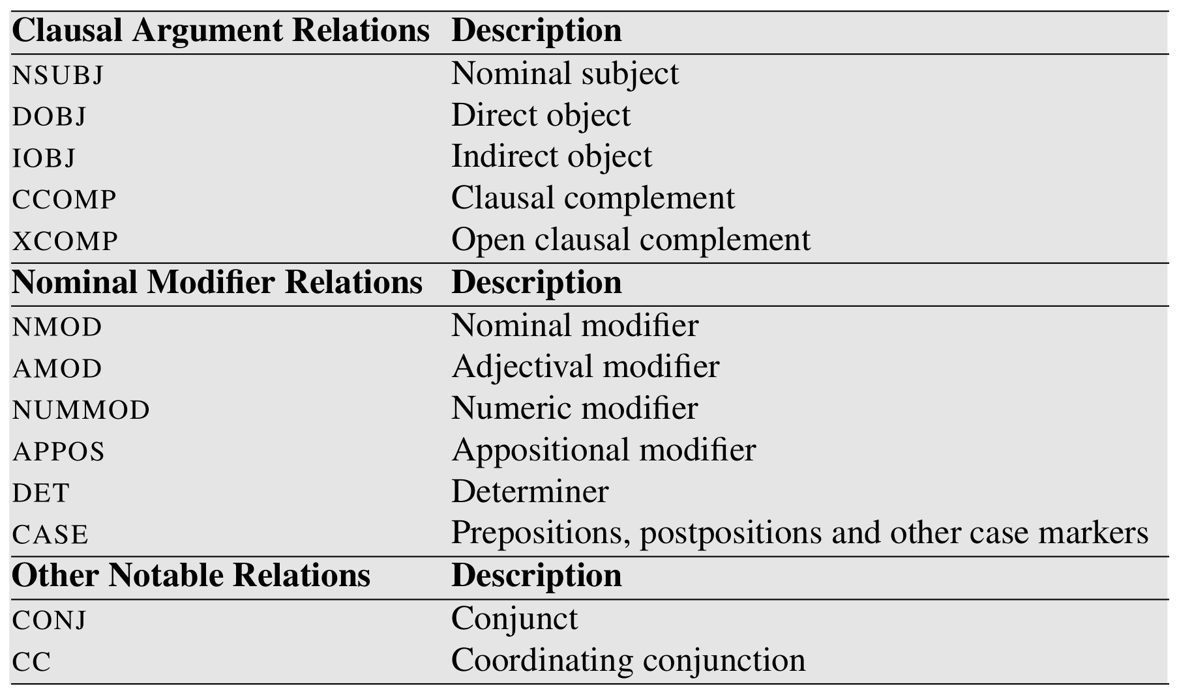
Dependency Labels

Slide 32
Dependency Trees
Notes:
Parent/head/governor, child/dependent/modifier, label/relation/type
Connected, acyclic, single-head, projective

Slide 33
Dependency Trees
Notes:
Parent/head/governor, child/dependent/modifier, label/relation/type
Connected, acyclic, single-head, projective

Slide 34
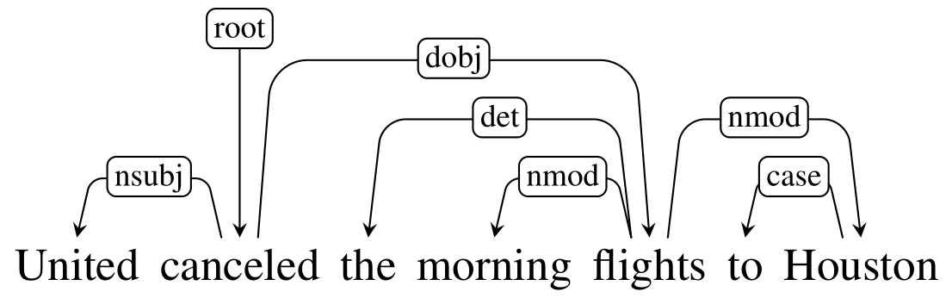
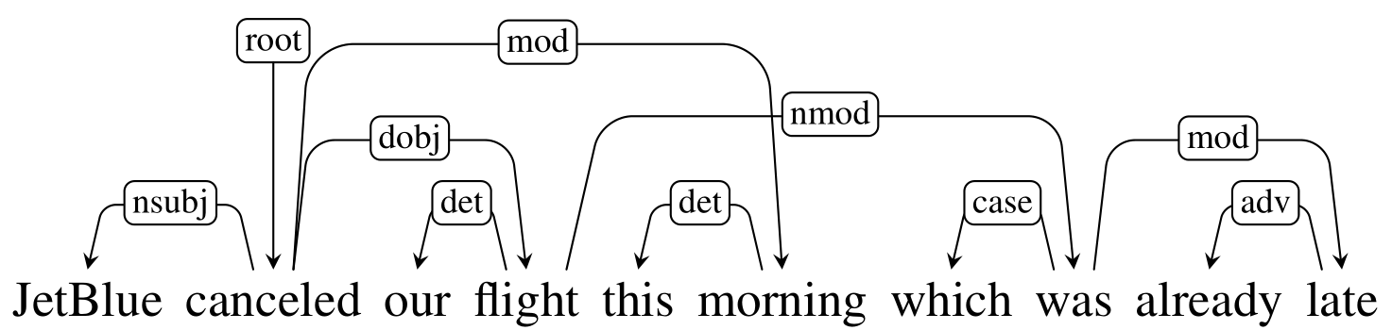
Projective vs Non-projective

Slide 35
Projective vs Non-projective

Slide 36
Evaluating Dependency Parses
ROOT She saw the video lecture
0 1 2 3 4 5
ROOT She saw the video lecture
0 1 2 3 4 5
Gold
2 She nsubj
0 saw root
5 the det
5 video nn
2 lecture dobj
Parsed
2 She nsubj
0 saw root
4 the det
5 video nsubj
2 lecture ccomp
Notes:
Labeled attachment score, unlabeled attachment score

Slide 37

Evaluating Dependency Parses
ROOT She saw the video lecture
0 1 2 3 4 5
ROOT She saw the video lecture
0 1 2 3 4 5
Gold
2 She nsubj
0 saw root
5 the det
5 video nn
2 lecture dobj
Parsed
2 She nsubj
0 saw root
4 the det
5 video nsubj
2 lecture ccomp
Notes:
Labeled attachment score, unlabeled attachment score

Slide 38
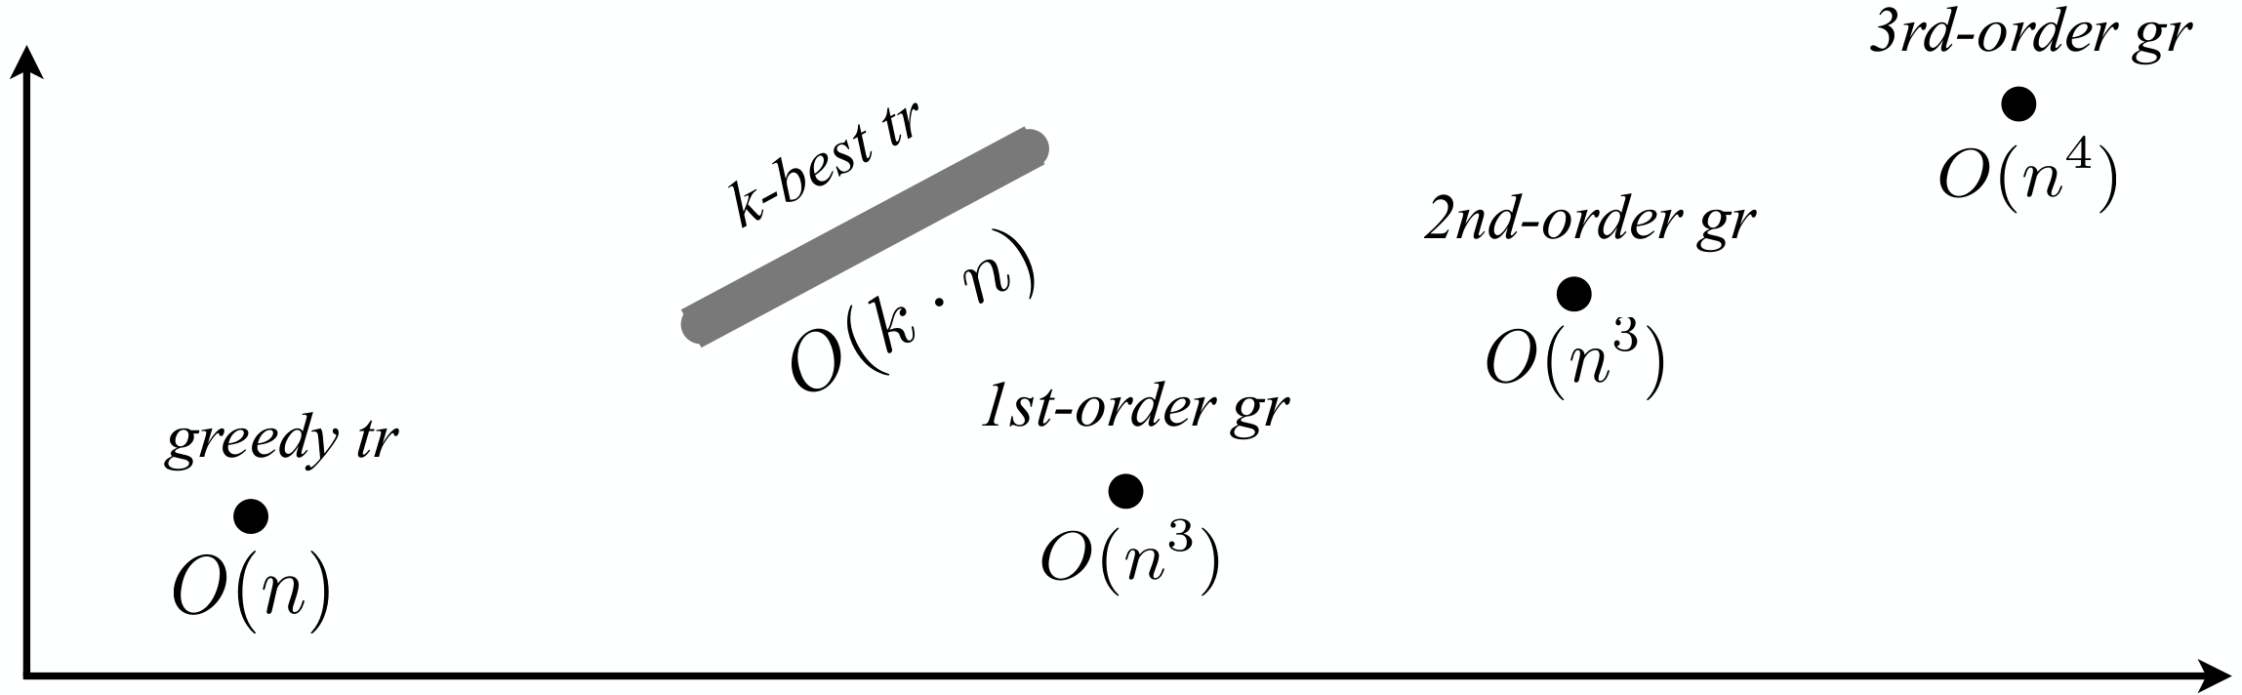
Parsing Algorithms
Transition-based
Graph-based
Fast, greedy, linear-time
Trained for greedy search
Features decide what to do next
Beam search, i.e. k-best
Slower, exhaustive algorithms
Dynamic programming, inference
Features used to score whole trees
Accuracy
Running time

Slide 39
Graph-based Parsing
Notes:
Arc-factored (1st order), 2nd order, 3rd order, and so on
Dynamic Programming for projective, MST for non-projective

Slide 40
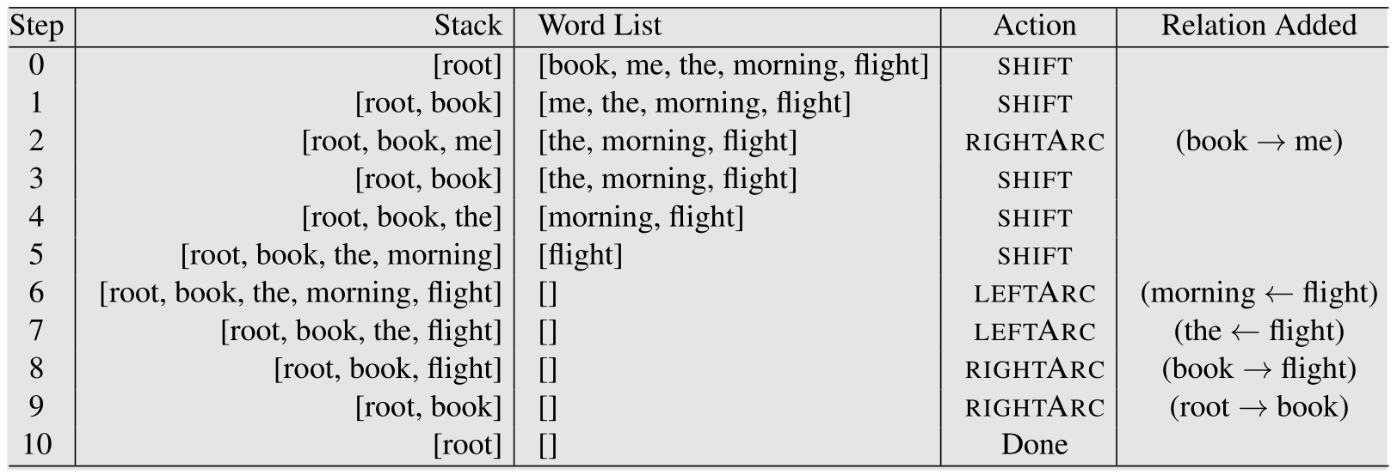
Transition-based Parsing

Slide 41
Transition-based Parsing

Slide 42
Transition-based Parsing

Slide 43
Transition-based Parsing

Slide 44
Transition-based Parsing

Slide 45
Transition-based Parsing

